Slide 1
Progress Seminar
By
Name: Aayush Deepak Birari
Roll no. 16030725021
SY M.Tech Computer Engineering
Guided by: Prof. Swapnil C. Pawar

Slide 2
Problem Statement
Beyond continuous monitoring: Probabilistic Seizure Forecasting Using Non-EEG Daily Routine Logs and Clinical Baselines.
Why Beyond Continuous Monitoring?
Why Non-EEG logs?
Anymore?

Slide 3
Objectives
Software-Driven Forecasting: Bypass expensive medical hardware using a scalable, non-invasive telemetry pipeline.
Multivariate Trigger Tracking: Monitor dynamic lifestyle vectors (dietary load, fatigue, stress, sleep, environment).
Dynamic Probability Modeling: Utilize a Discrete Bayesian Belief Network to calculate immediate seizure risk.
Systemic Baseline Integration: Map neuro-metabolic triggers to Ayurvedic tri-dosha frameworks (Vata, Pitta, Kapha).
Proactive Early-Warning System: Deliver a real-time, confidential dashboard to prevent threshold collapse.

Slide 4
Literature Review
Author(s) & Year | Thematic Group | Research Objective / Domain | Methodology / Computational Model | Key Limitations (The Research Gap)
Trabelsi et al. (2026) | Hardware-Reliant ML & MLOps | Automating deep learning pipelines for EEG-based epilepsy prediction. | End-to-end MLOps Framework using CNN-BiLSTM networks. | Strictly relies on continuous EEG hardware; fails in real-world ambulatory environments due to patient mobility.
Abderrahim et al. (2022) | Hardware-Reliant ML & MLOps | Seizure prediction using intracranial brainwave signals. | Deep Learning Convolutional Neural Networks (CNNs). | Highly invasive (intracranial electrodes); acts as a "black box" model without transparent clinical reasoning.

Slide 5
Literature Review
12Author(s) & Year | Thematic Group | Research Objective / Domain | Methodology / Computational Model | Key Limitations (The Research Gap)
Rojas-López et al. (2026) | Psychosocial & Trigger Diagnostics | Evaluating psychiatric comorbidities (depression/anxiety) in adult epilepsy. | Systematic Review and Meta-Analysis. | Highlights that psychosocial stress actively triggers events, but offers no computational framework to track this stress daily.
Braga et al. (2020) | Psychosocial & Trigger Diagnostics | Assessing the cultural stigma, fear, and psychosocial consequences of epilepsy. | Qualitative Review & Analysis. | Proves the intense quality-of-life impact of unpredictability but lacks a predictive software solution to empower patients.

Slide 6
Literature Review
Author(s) & Year | Thematic Group | Research Objective / Domain | Methodology / Computational Model | Key Limitations (The Research Gap)
Gui et al. (2025) | Psychosocial & Trigger Diagnostics | Analyzing psychiatric adverse events resulting from antiseizure medication. | Statistical signal detection (FAERS database analysis). | Demonstrates the negative psychiatric impact of chemical medications, reinforcing the need for non-pharmacological lifestyle tracking.
Dwivedi et al. (2024) | Integrative Baselines (Ayurveda) | Mapping neurological disorders to Ayurvedic baselines. | Machine Learning classification mapping to the Vata Dosha. | Validates that Doshas can be digitized via ML, but lacks a dynamic time-series forecasting engine for daily trigger tracking.

Slide 7
Literature Review
Author(s) & Year | Thematic Group | Research Objective / Domain | Methodology / Computational Model | Key Limitations (The Research Gap)
Mishra et al. (2019) | Integrative Baselines (Ayurveda) | Management of epileptic seizures through integrated, holistic approaches. | Clinical / Observational Approach. | Explores alternative systemic management but entirely lacks a modern predictive software infrastructure.
Chithralatha (2009) | Integrative Baselines (Ayurveda) | Management of neurological conditions (Migraine) via Ayurvedic baselines. | Observational Study. | Validates the role of systemic Dosha imbalances (Pitta/Vata) in neurology but is strictly observational, not predictive.

Slide 8
Literature Review
Author(s) & Year | Thematic Group | Research Objective / Domain | Methodology / Computational Model | Key Limitations (The Research Gap)
Mueller et al. (2013) | Probabilistic Modeling | Classification of partial epilepsy using multi-modality imaging. | Two-level Bayesian Belief Network (BBN). | Utilized Bayesian networks successfully for static diagnostic imaging, but not deployed for daily, time-series event forecasting.
Hashemi et al. (2023) | Probabilistic Modeling | Spatio-temporal seizure propagation mapping. | Amortized Bayesian Inference and deep neural density estimators. | Requires heavy clinical imaging (MRI/DTI) and continuous monitoring; socioeconomically unscalable for daily use.

Slide 9
Literature Review
Author(s) & Year | Thematic Group | Research Objective / Domain | Methodology / Computational Model | Key Limitations (The Research Gap)
Flegel et al. (2024) | Probabilistic Modeling | Predicting canine structural epilepsy. | Machine learning classification algorithms. | Focuses strictly on structural brain disorders (SBD) rather than functional, lifestyle-induced threshold degradation.

Slide 10
Continuous Telemetry Architecture
Logging Inference Forecasting
Automated Google fit Bayesian Network Real-Time Dashboard
Synchronization. Probability Calculation. Risk Alerts.
L
I
F

Slide 11
LIF ALGORITHM
START
Patient Logging
Patient Registration
AI Processing
Database Update
History Backfill
(Optional)
Comparative Analysis
Save Profile & history
Matching Logic 1
Yes
Seizure Risk: High Risk
Secure Access Login
Dashboard Visualization
No
Stress Evaluation
No
Authentication Check
Yes
Seizure Risk: Moderate Risk
Yes
END
No
Seizure Risk: Low Risk

Slide 12
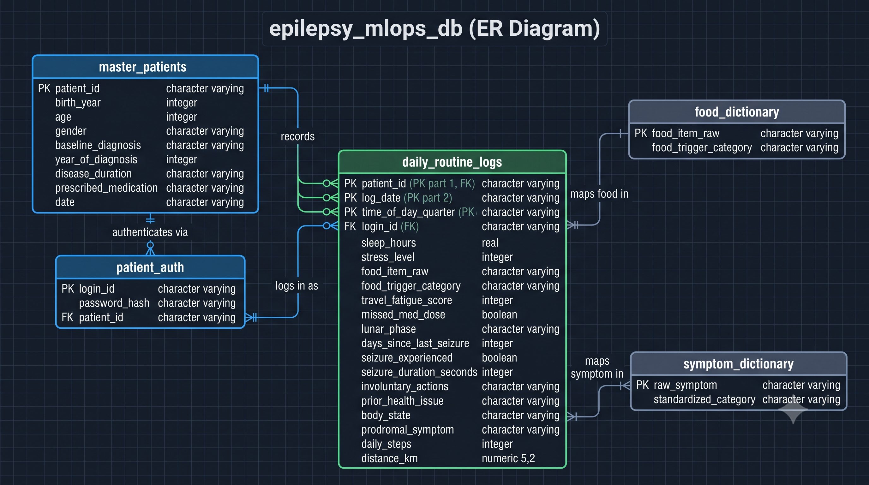
ER Diagram
Database epilepsy_mlops_db

Slide 13
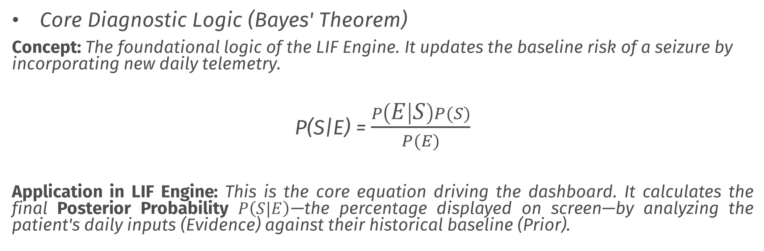
Mathematical Model
Core Diagnostic Logic (Bayes' Theorem)
Concept: The foundational logic of the LIF Engine. It updates the baseline risk of a seizure by incorporating new daily telemetry.
P(S|E) = $\frac{P\left(E | S\right)P(S)}{P(E)}$
Application in LIF Engine: This is the core equation driving the dashboard. It calculates the final Posterior Probability $P\left(S|E\right)$—the percentage displayed on screen—by analyzing the patient's daily inputs (Evidence) against their historical baseline (Prior).

Slide 14
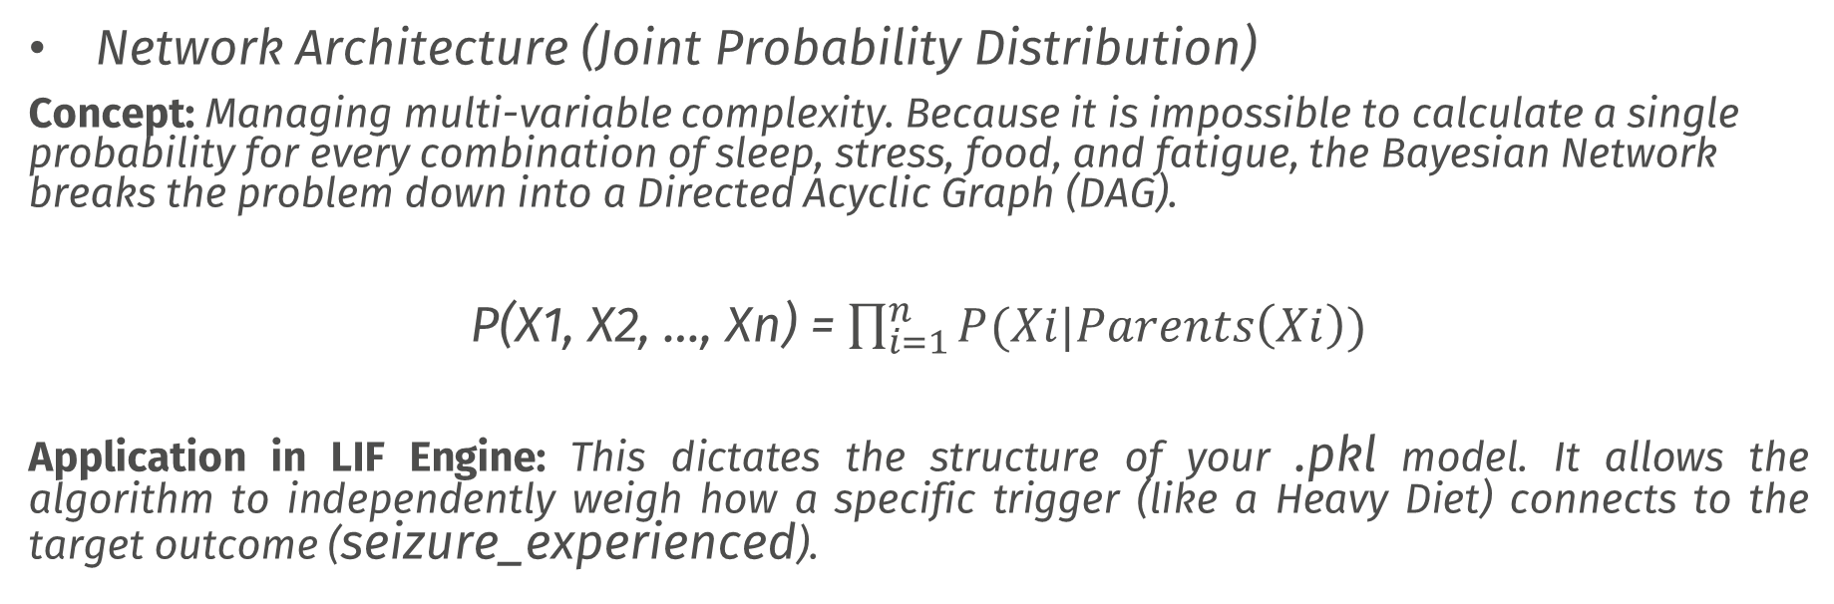
Mathematical Model
Network Architecture (Joint Probability Distribution)
Concept: Managing multi-variable complexity. Because it is impossible to calculate a single probability for every combination of sleep, stress, food, and fatigue, the Bayesian Network breaks the problem down into a Directed Acyclic Graph (DAG).
P(X1, X2, …, Xn) = $\prod_{i=1}^{n}{P(Xi|Parents\left(Xi\right))}$
Application in LIF Engine: This dictates the structure of your .pkl model. It allows the algorithm to independently weigh how a specific trigger (like a Heavy Diet) connects to the target outcome (seizure_experienced).

Slide 15
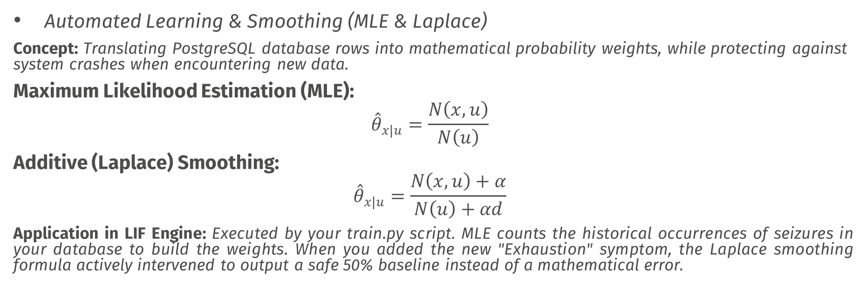
Mathematical Model
Automated Learning & Smoothing (MLE & Laplace)
Concept: Translating PostgreSQL database rows into mathematical probability weights, while protecting against system crashes when encountering new data.
Maximum Likelihood Estimation (MLE):
$${\overset{ˆ}{θ}}_{x|u}=\frac{N\left(x,u\right)}{N\left(u\right)}$$
Additive (Laplace) Smoothing:
$${\overset{ˆ}{θ}}_{x|u}=\frac{N\left(x,u\right)+α}{N\left(u\right)+αd}$$
Application in LIF Engine: Executed by your train.py script. MLE counts the historical occurrences of seizures in your database to build the weights. When you added the new "Exhaustion" symptom, the Laplace smoothing formula actively intervened to output a safe 50% baseline instead of a mathematical error.

Slide 16
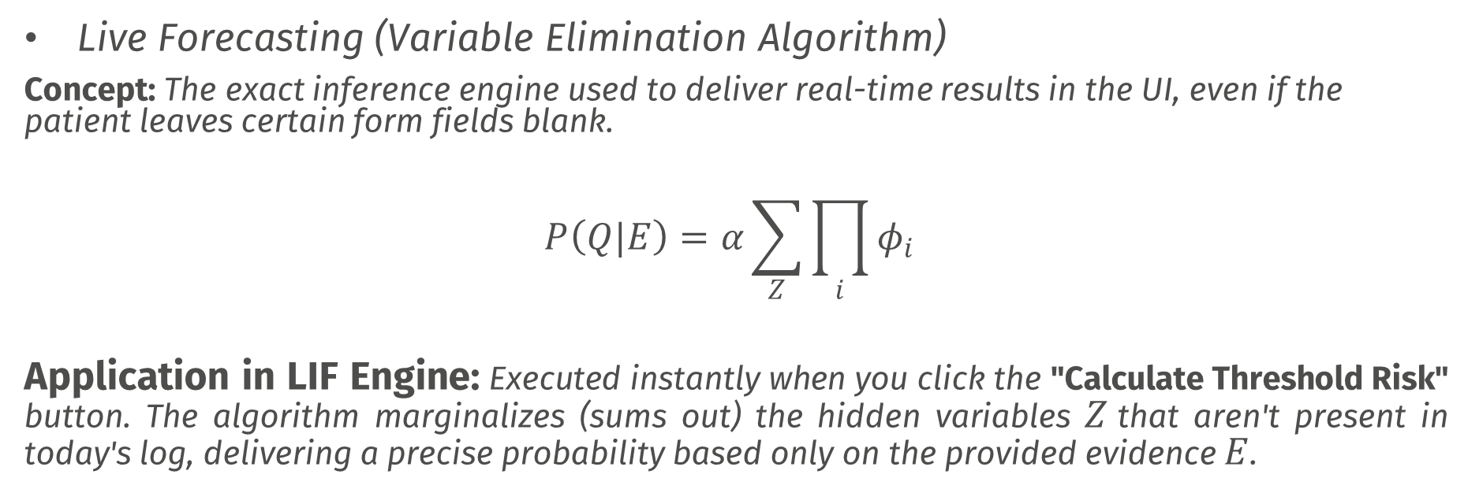
Mathematical Model
Live Forecasting (Variable Elimination Algorithm)
Concept: The exact inference engine used to deliver real-time results in the UI, even if the patient leaves certain form fields blank.
$$P\left(Q|E\right)=α\sum_{Z}{\prod_{i}{φ_{i}}}$$
Application in LIF Engine: Executed instantly when you click the "Calculate Threshold Risk" button. The algorithm marginalizes (sums out) the hidden variables $Z$that aren't present in today's log, delivering a precise probability based only on the provided evidence $E$.

Slide 17
Docker Containerization Design
External Environment
Patient/User
Google Fit API
CI/CD Trigger / GitHub Actions
Request Oauth 2.0
Return Telemetry (Steps/Sleep)
Trigger Model Retraining
Docker Engine (docker-compose)
Persistent Docker Volumes Isolated Microservices (lif-network)
pg_data_volume
PostgreSQL Storage
Access UI (Port 8501)
lif-frontend
Streamlit Dashboard
Exposed port: 8501, 8080
Hot – reloads .pkl for inference
Save Logs & Dictionary Maps (UPSERT)
model_volume
(Shared inference.pkl)
lif-database
PostgreSQL 15
Internal Port: 5432
lif-ml-worker
Headless Python Environment
Fetch 2 lakh+ Rows
For MLE (SQL)
Mounts & Persists Data
Serializes new .pkl

Slide 18
CI/CD Pipeline Design
CI/CD Pipeline Triggers
Jenkins Automation Server
Pipeline Stages
1.
2.
3.
4.
Continuous Delivery (CD) / Deployment
Deployment Process
Code Push / Merge
(GitHub)
Pushing app.py, train.py, or pipeline changes
Stage 1: Checkout & DVC Pull
Pull Git source and gets dataset pointers using DVC
DVC Commit
Records the dataset and mobile state
Hot-Swap CD
Quietly pushes the new ‘inference.pkl’ to the shared ‘model_volume’, making it immediately active
Stage 2: Pre-training Validation
Verifies database schemas, clean data.
Database Insertion (PostgreSQL)
Daily logs or newly mapped items like ‘Exhaustion’.
Stage 3: Automated ML Training
Jenkins worker triggers container running ‘lif-ml-worker’ to execute train.py on over 2L+ rows.
Live reload on ‘lif-frontend’ (Port 8501)
Running StreamLit app without downtime
Nightly CRON
Scheduled periodic retraining
Stage 4: Evaluation & Artifact Registering
Confirms accuracy, evaluates performance, serializes optimized ‘inference.pkl’.
Alerts & Notification Update
Sends status to console or Telegram/Stack

Slide 19
DVC (Data Version Control)
Local Project Workspace
Version Control Dual-Pipeline
----------Git VCS Pipeline--------
git commit & git push
Pushes tiny text files only (<1 MB)
---------DVC Data Pipeline---------dvc commit Pushes heavy assets & dvc push by content- addressable hash
Remote Storage & Repositories
Local Workspace
Workspace (Git + DVC)
GitHub / Remote Git Repository
src/code & .dvc
Lightweight code & Pointers
Code & metapointers
(Lightweight)
Lightweight Code & .dvc Pointers
Remote Code Repository
DVC Remote Storage
(Cloud / Remote)
Massive Dataset & Binary Store
(e.g. AWS S3, G Drive, GCP Storage)
src/train.py
src/app.py
dvc.yaml
daily_routine_logs.csv.dvc
inference.pkl.dvc
MLOps Data-Pipeline Reproducibility:
How they lock together
Git tracks the metadata (.dvc) to know which code was used.
DVC tracks the payload (Data/Models) by their unique hash.
Command ‘dvc pull’ lets restore exact matching.
Huge Data & Models
(Heavy)
daily_routine_logs.csv
(2 lakhs+ Rows Data Snapshot)
Models/inference.pkl
(Bayesian weights)
Heavy Large Data & Models
Local DVC Cache (.dvc/
Cache)
Remote Large Storage

Slide 20
Comparative Analysis:
Neuphony EEG vs. LIF Algorithm
Feature | Neuphony EEG Headband | LIF Forecasting Engine (Proposed)
Core Architecture | Hardware-centric wearable device | Software-centric MLOps telemetry pipeline
Data Acquisition | Direct electrical brainwaves (8 dry EEG sensors) | Non-invasive lifestyle logging & API wearables (Google Fit)
Primary Output | Real-time cognitive states (stress, focus, mood) | Predictive forecasting (Bayesian Probability of seizure)
Cost & Accessibility | High (Approx. ₹49,000) | Zero hardware cost (Utilizes existing smartphones)
Patient Burden | Active wearability (must wear cap/headband, limited battery) | Ambient tracking (async form logging, passive step counting)
Clinical Mapping | Standard western neuro-feedback | Integration with Ayurvedic metabolic baselines (Tri-dosha)

Slide 21
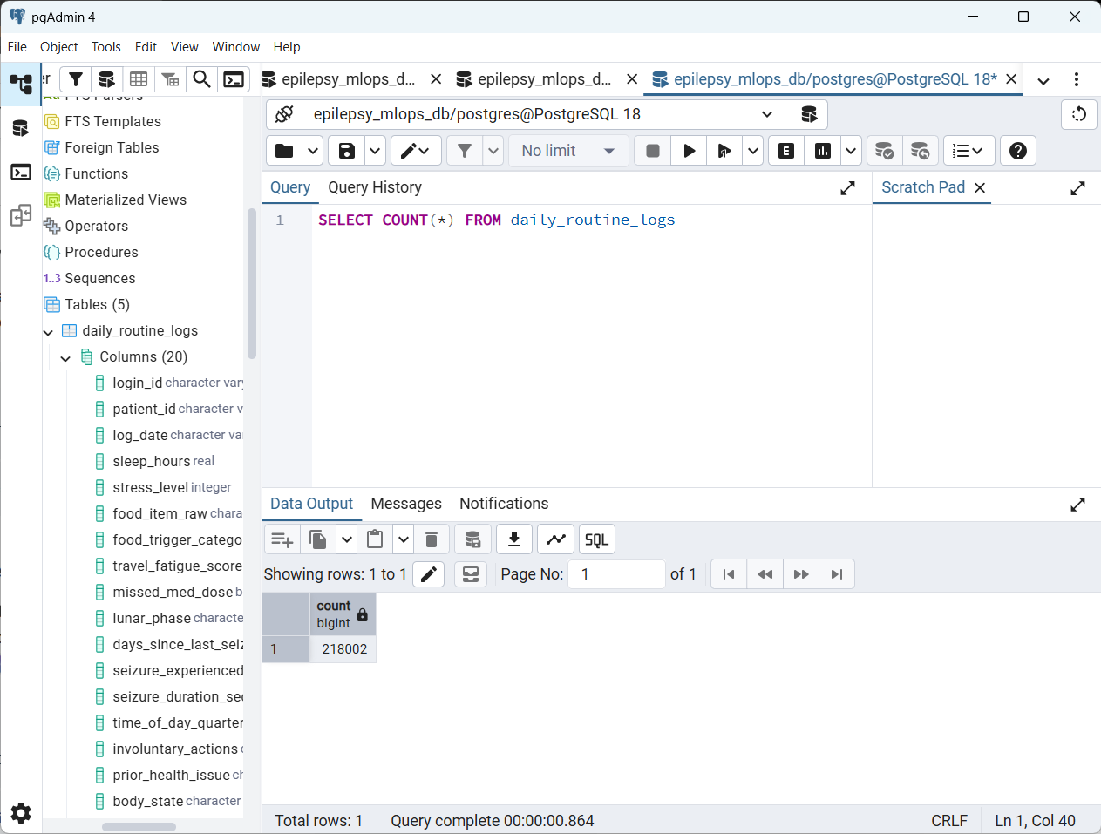
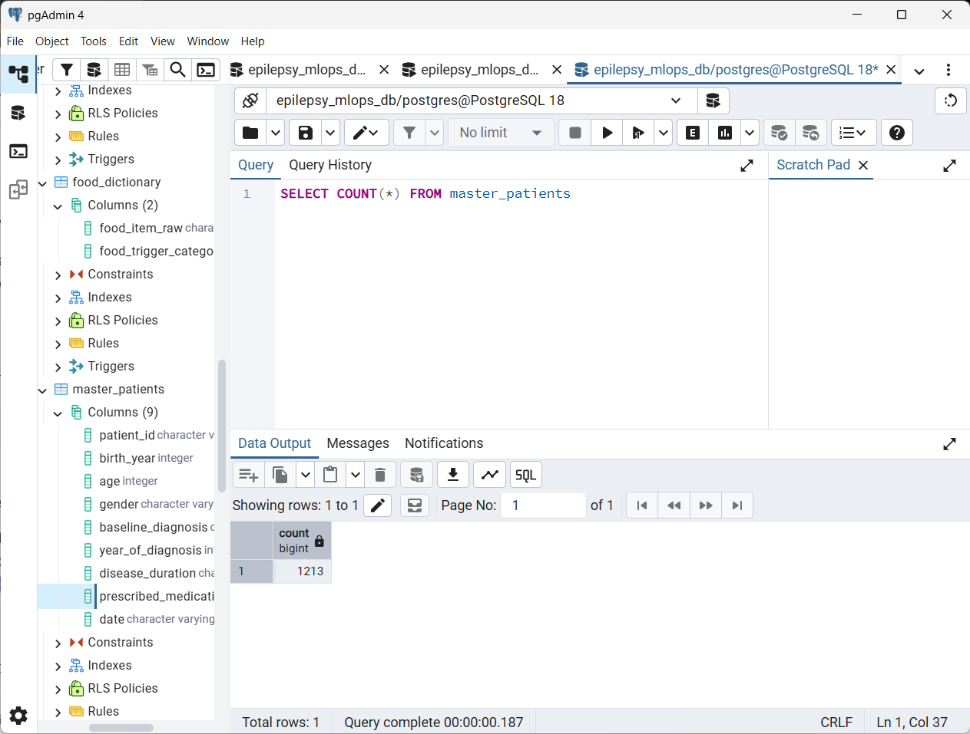
Implementation till now
Total entries in database

Slide 22
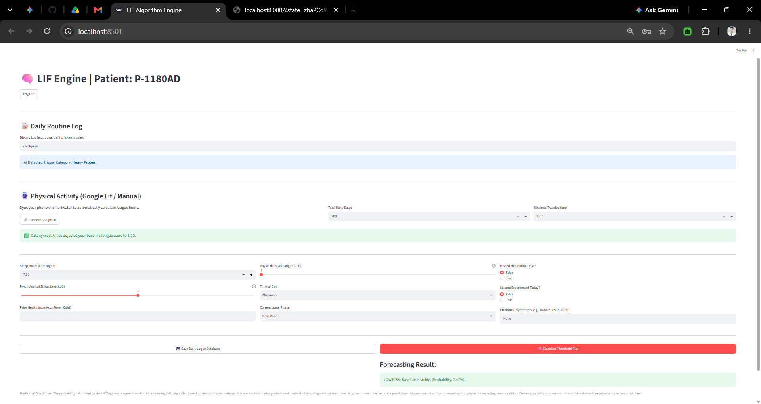
Preliminary Results
Low risk 7.47% when input parameter are low or not harmful for patient

Slide 23
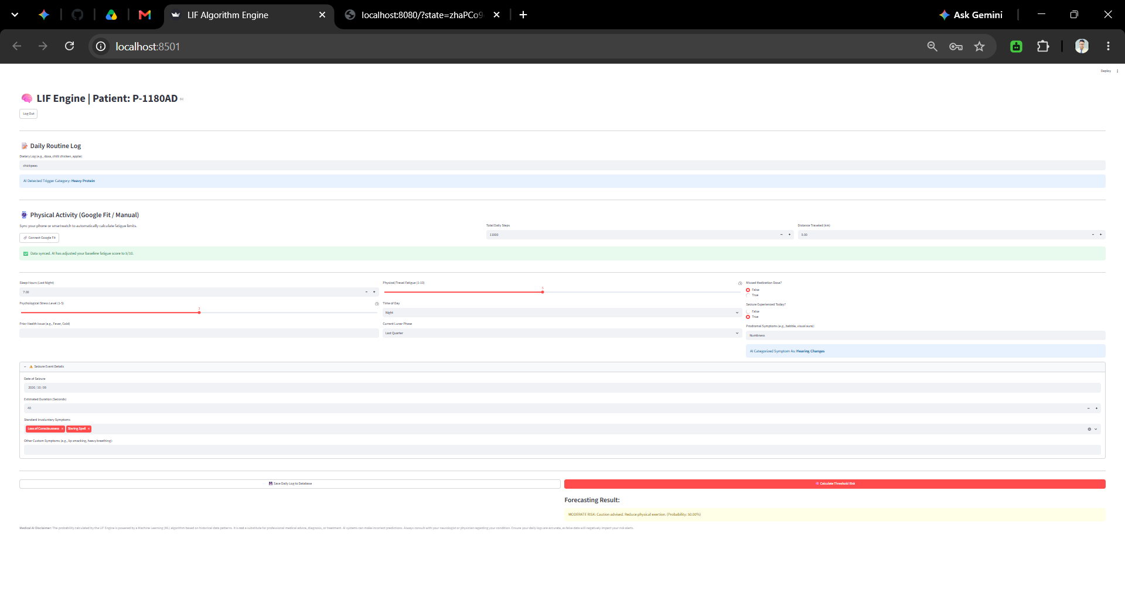
Preliminary Results
Moderate risk 50% when input parameter are High or harmful for patient
Localhost:8501

Slide 24
Pending Work
Jenkins CI/CD Pipeline
Docker Containerization
Training model for best accuracy
Deployment
Research Paper Drafting and Publishing
Literature Survey Publishing

Slide 25
Conclusion
According to the survey over 50 million people in the world are affected by the seizure or epilepsy.
Health problem which occurs involuntarily.
Forecast it and alert the patients early to avoid risk
Not every patients can get EEG or any parameter continuously
The daily routine activities can help monitor which things affect and lead to seizure attack.

Slide 26
References
Neuphony Headband:
https://www.neuphony.com/product/brain-wearables/neuphony-eeg-headband
A two-level multimodality imaging Bayesian network approach for classification of partial epilepsy: Preliminary data
https://www.sciencedirect.com/science/article/abs/pii/S105381191300061X
Management of Epileptic Seizures through an Integrated Approach including Yagya Therapy.
https://www.researchgate.net/profile/Shilpi-Verma-5/publication/334734894_Management_of_Epileptic_Seizures_through_an_Integrated_Approach_including_Yagya_Therapy/links/5e60961e92851cefa1dee654/Management-of-Epileptic-Seizures-through-an-Integrated-Approach-including-Yagya-Therapy.pdf?_sg%5B0%5D=started_experiment_milestone&origin=journalDetail

